Slide 1
Just released
Adds Support for
Q-SYS NV-21-HU Network Video Endpoint
Added Flexibility:
SPA-Q Series Standalone Mode

Slide 2
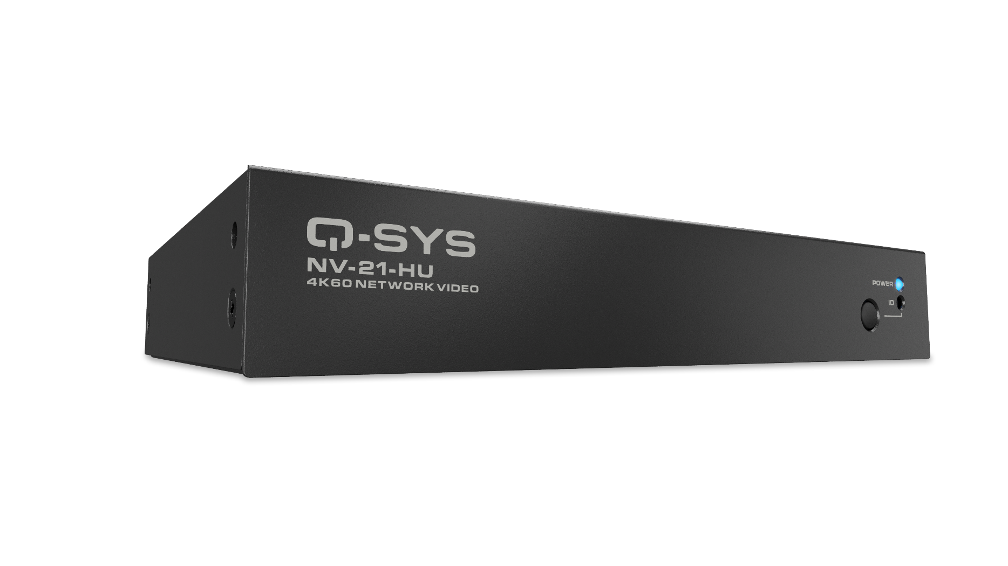
NV-21-HU Network Video Endpoint
Introducing the next evolution for native Q-SYS video distribution.
The NV-21-HU is a software configurable endpoint offering a comprehensive single-cable solution for video distribution, AV bridging, and device charging via USB-C.
*Due to temporary software limitations, the AV Bridging feature license will be included with the purchase of each NV-21-HU (for a limited time). Click here to learn more.
Benefits
Delivers one of the most requested products to the Q-SYS Video portfolio
Reduced I/O extends Q-SYS network video capabilities to broader applications
Provides more flexibility in system design, ensuring customers needs are met

Slide 3
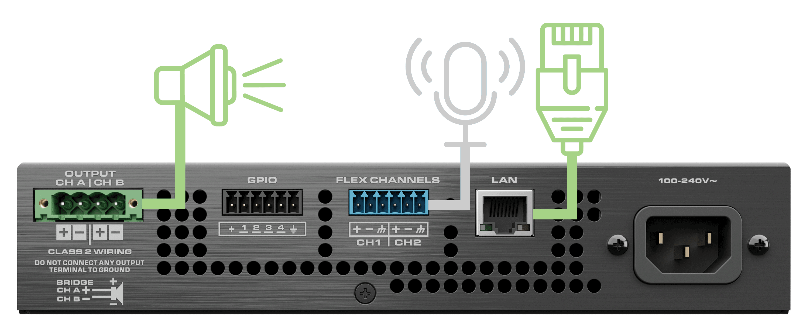
SPA-Q Standalone Mode
When the unexpected occurs to your network and the connection to the Q-SYS Core is lost, ensure your SPA-Q network amplifier can still pass audio to a loudspeaker from a connected analog input signal.
Benefits
Avoid disruption and ensure audio reaches listeners when and where it needs to
Strengthens the Q-SYS software story, adding functionality through simple firmware updates

